Slide 1
VETRI CINEMA’S FOODS APP
Janani, UX designer

Slide 2
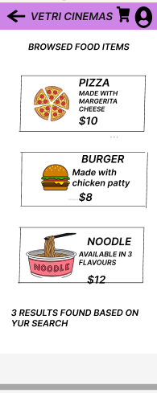
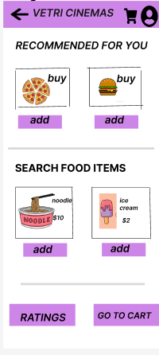
Project overview
The product:
Vetri cinema’s foods app is an app designed exclusively for ordering foods and snacks in Vetri theaters in tamil Nadu. This app allows us to order snacks without waiting in lines. We can order our favourite foods while being seated in our seats.
Project duration:
15th August 2022 to 30th october 2022

Slide 3
Project overview
The problem:
The cinema viewers find it frustrating to wait in queues for long time to buy snacks
The goal:
Design an app for Vetri Cinemas that allows users to easily order snacks online.

Slide 4
Project overview
My role:
UX designer designing an app for Vetri Cinemas for ordering the snacks.
Responsibilities:
Conducting interviews, paper and digital wireframing, low and high-fidelity prototyping, conducting usability studies, accounting for accessibility, and iterating on designs.

Slide 5
Understanding
the user
User research
Personas
Problem statements
User journey maps

Slide 6
User research: summary
I conducted interviews and created empathy maps to understand the users I’m designing for and their needs. A primary user group identified through research was working adults who don’t have time to cook meals.
This user group confirmed initial assumptions about Vetri Cinema food app, but research also revealed that time was not the only factor limiting users from buying snacks by standing in queues. Other user problems included obligations, interests, or challenges that make it difficult to get snacks from stalls in theaters.

Slide 7
User research: pain points
1
2
3
Time
Accessibility
IA
Users don’t want to spend more time in waiting for buying snacks
Platforms for ordering food in theaters are not equipped with assistive technologies
Text-heavy menus in apps are often difficult to read and order from

Slide 8
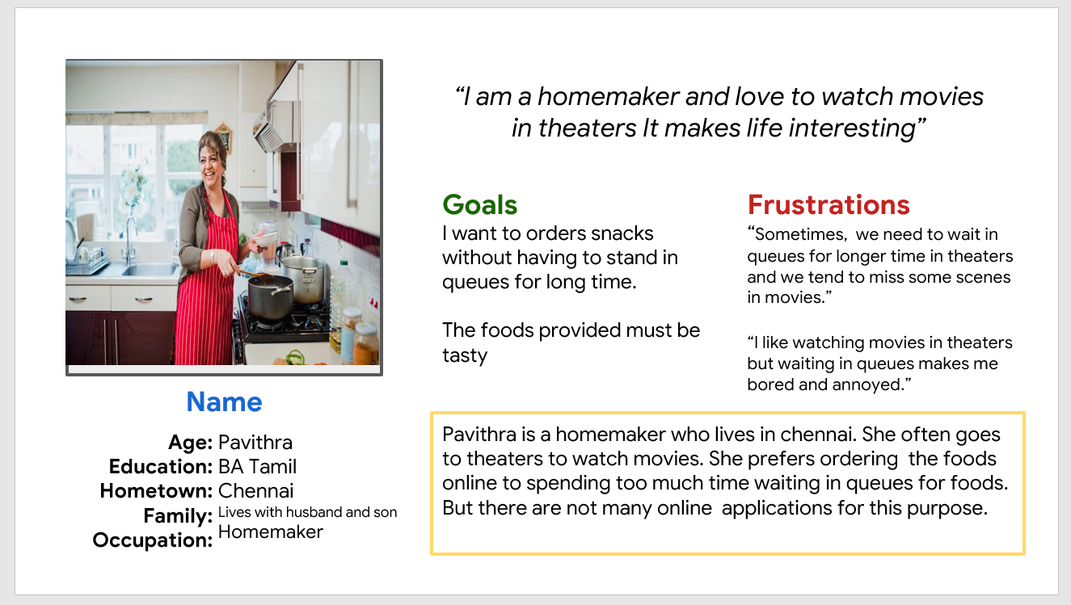
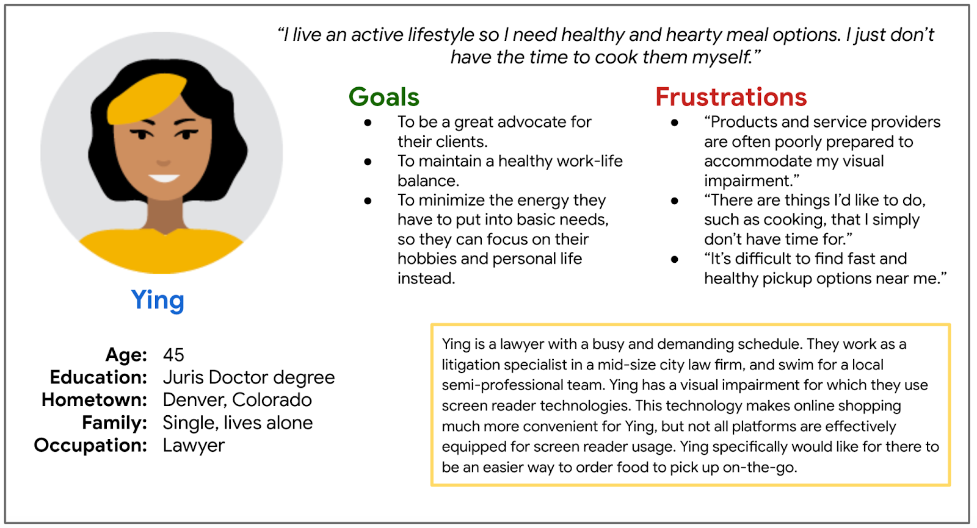
Persona: Ying
Problem statement:
Pavithra is a homemaker who likes to visit cinema theaters often. She wants an application that helps to order her favourite snacks online without having to move from her seat.

Slide 9
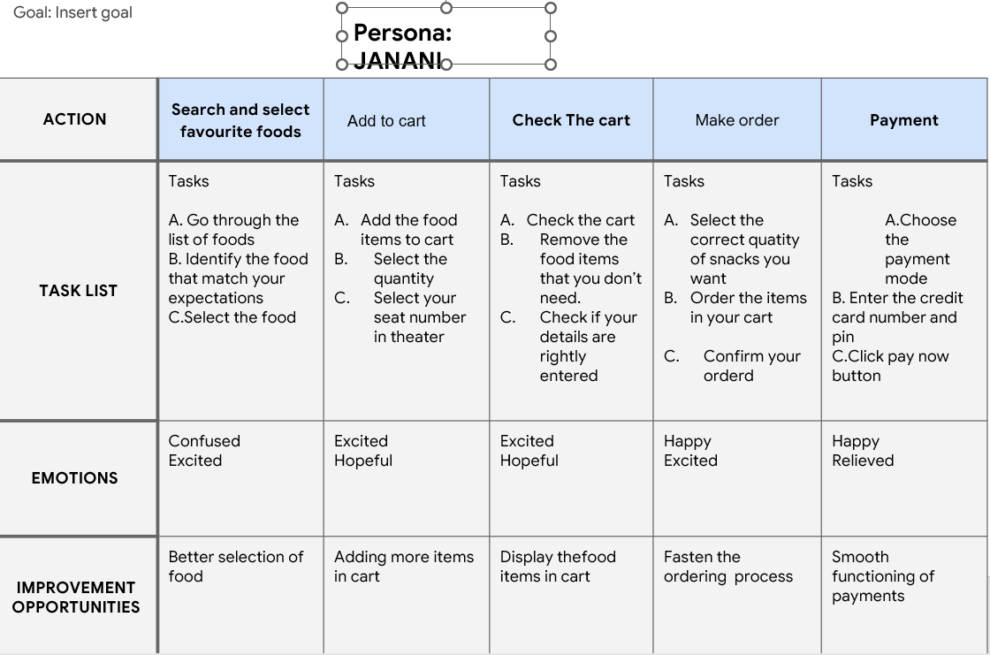
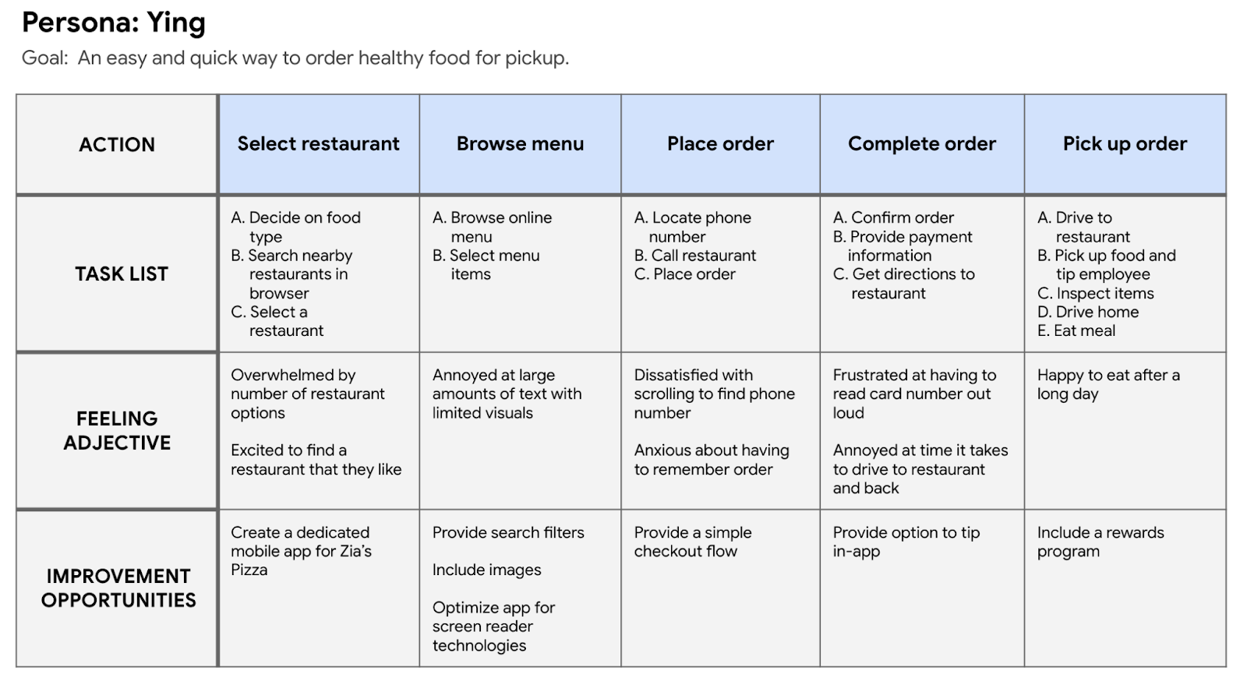
User journey map
Mapping janani’s user journey revealed how helpful it would be for users to have access to a dedicated Vetri cinemas food app.

Slide 10
Starting
the design
Paper wireframes
Digital wireframes
Low-fidelity prototype
Usability studies

Slide 11
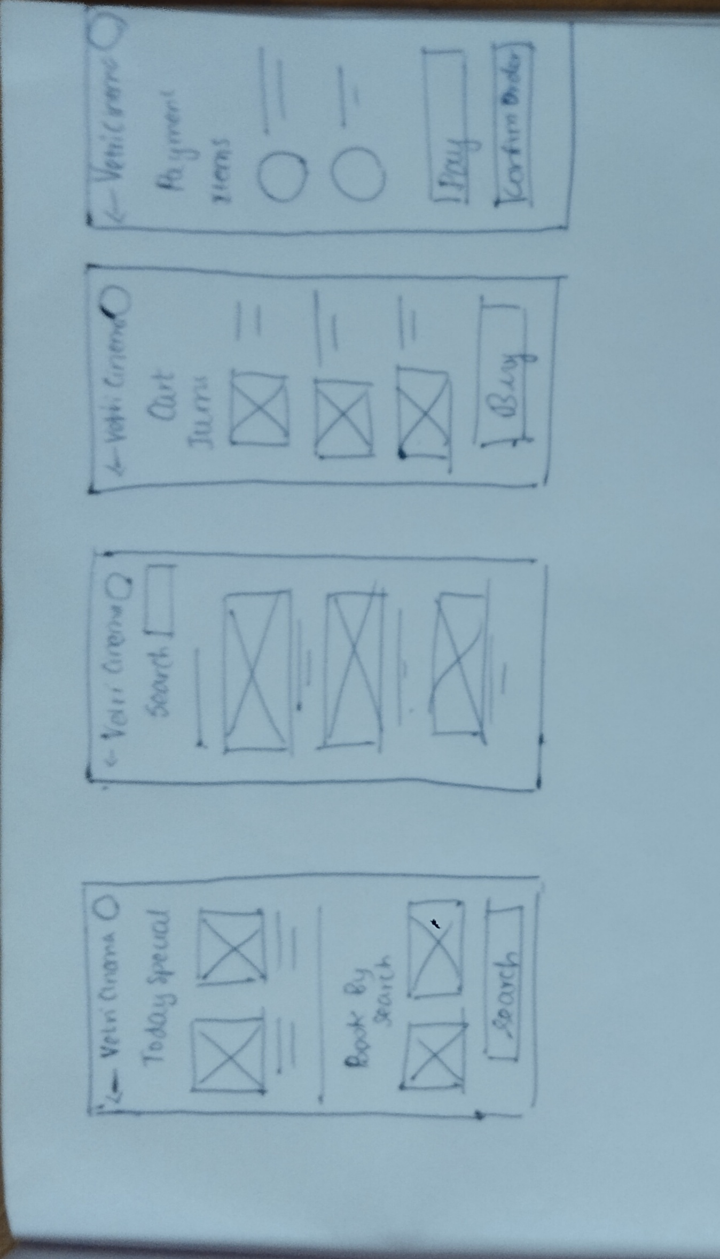
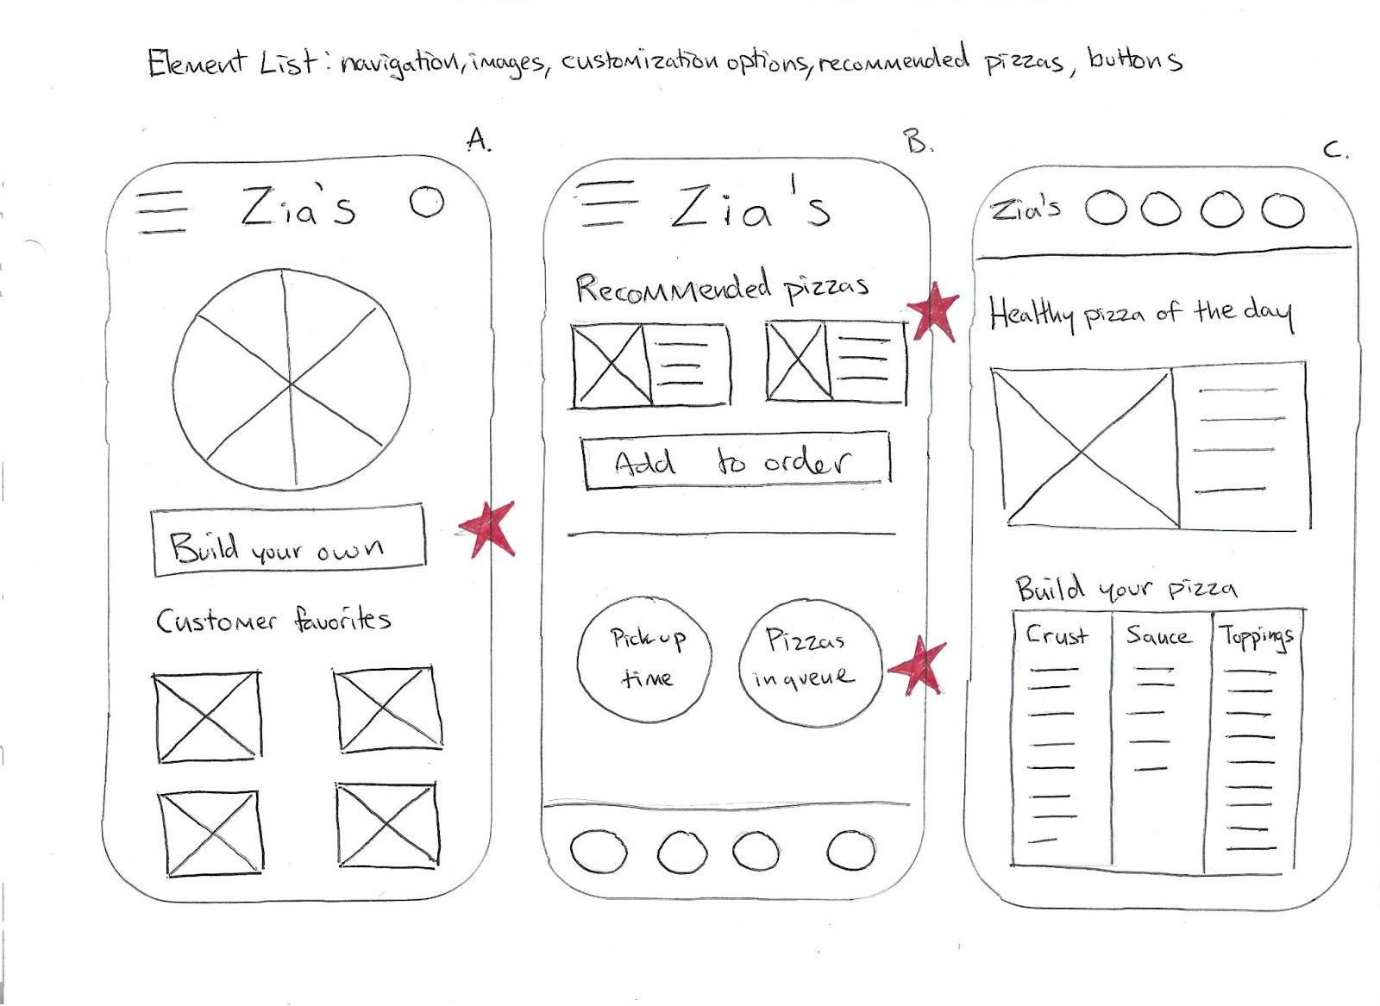
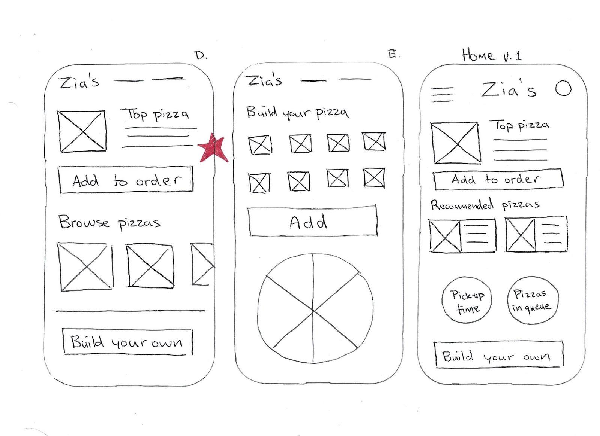
Paper wireframes
Taking the time to draft iterations of each screen of the app on paper ensured that the elements that made it to digital wireframes would be well-suited to address user pain points. For the home screen, I prioritized a quick and easy ordering process to help users save time.
Stars were used to mark the elements of each sketch that would be used in the initial digital wireframes.

Slide 12
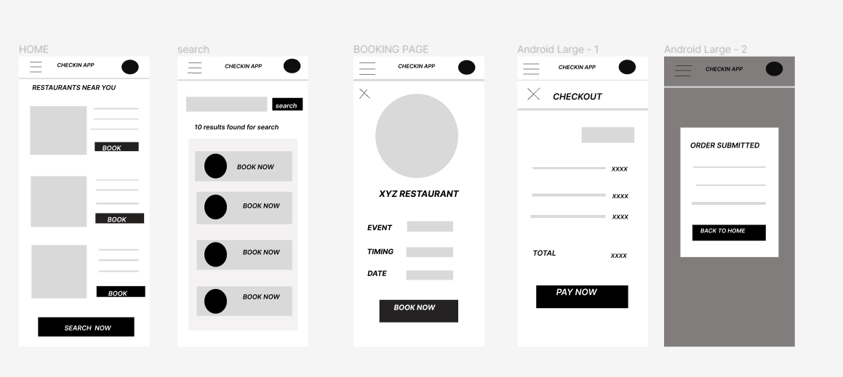
Digital wireframes
As the initial design phase continued, I made sure to base screen designs on feedback and findings from the user research.
This button provides an easy option for users to make their own pizza.

Slide 13
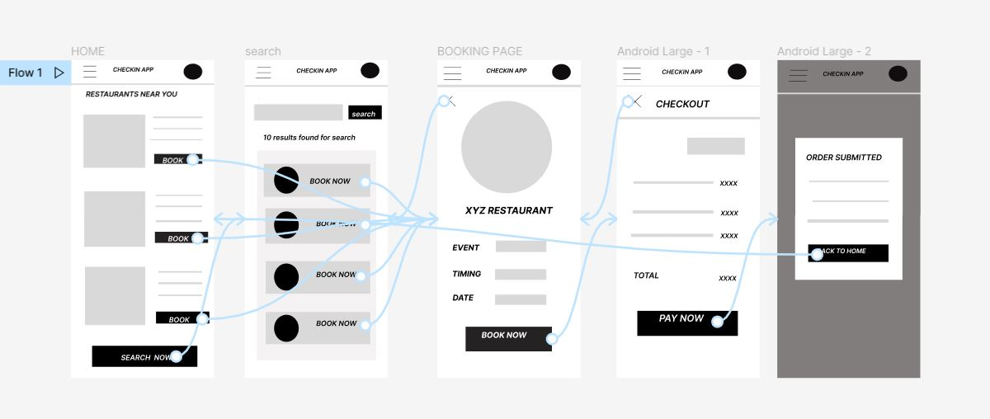
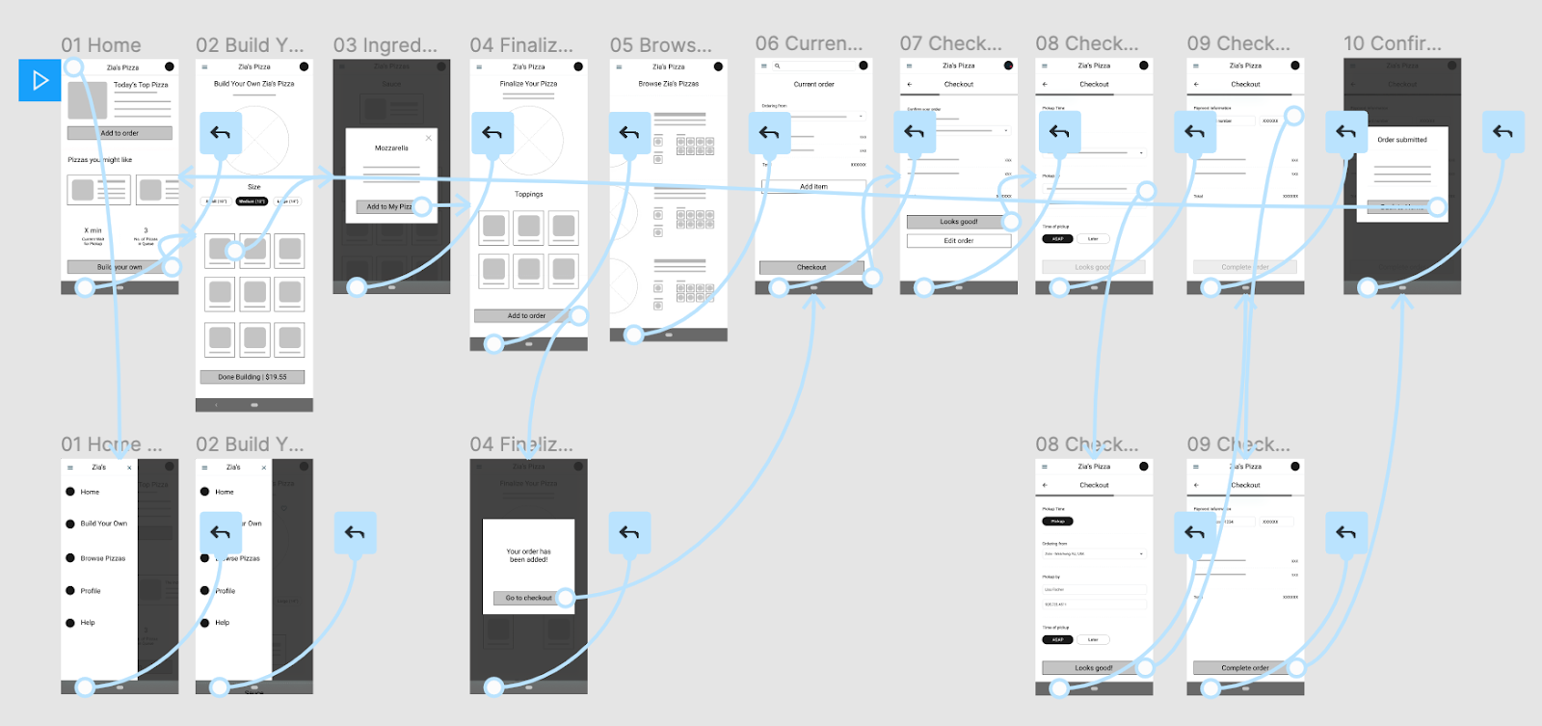
Low-fidelity prototype
Using the completed set of digital wireframes, I created a low-fidelity prototype. The primary user flow I connected was building and ordering a pizza, so the prototype could be used in a usability study.
View the Zia's Pizza low-fidelity prototype

Slide 14
Usability study: findings
I conducted two rounds of usability studies. Findings from the first study helped guide the designs from wireframes to mockups. The second study used a high-fidelity prototype and revealed what aspects of the mockups needed refining.
Round 1 findings
Round 2 findings
1
Users want a search engine
1
The customers wanted a remove from cart
Users want more customization options
The customers want the site to be more interactive
2
2
3
Users want a confirm payment page

Slide 15
Refining
the design
Mockups
High-fidelity prototype
Accessibility

Slide 16
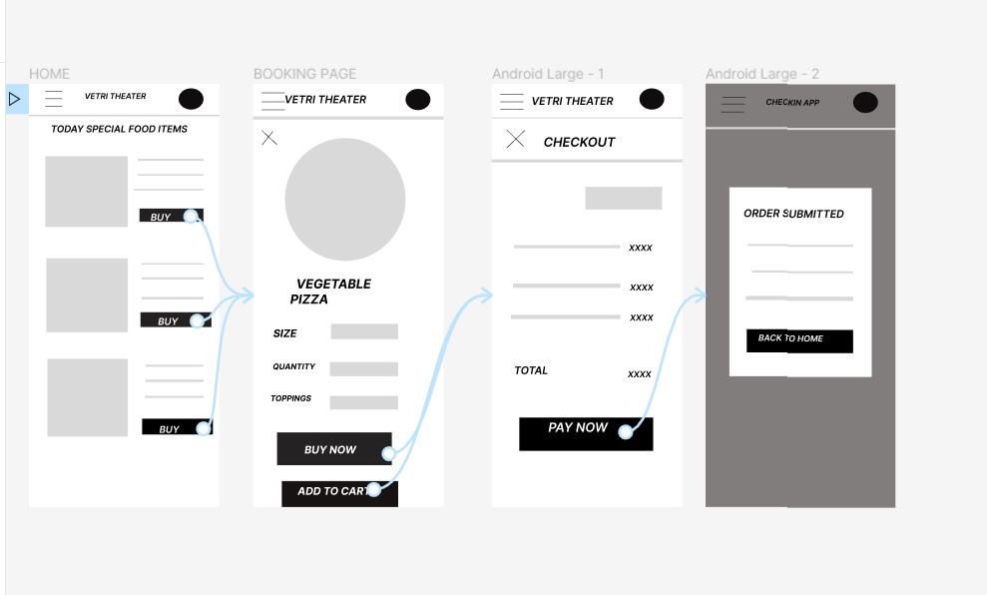
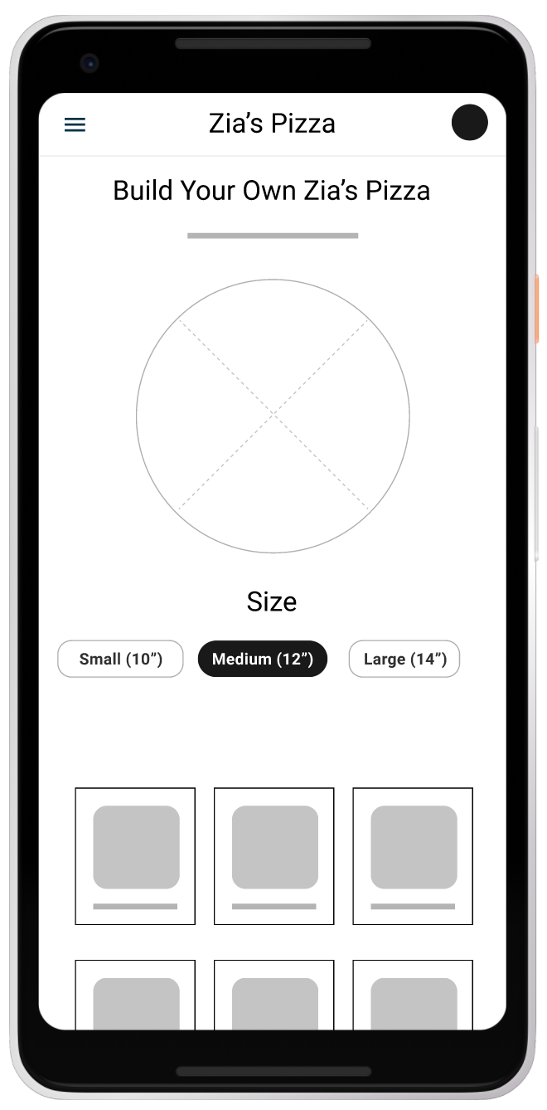
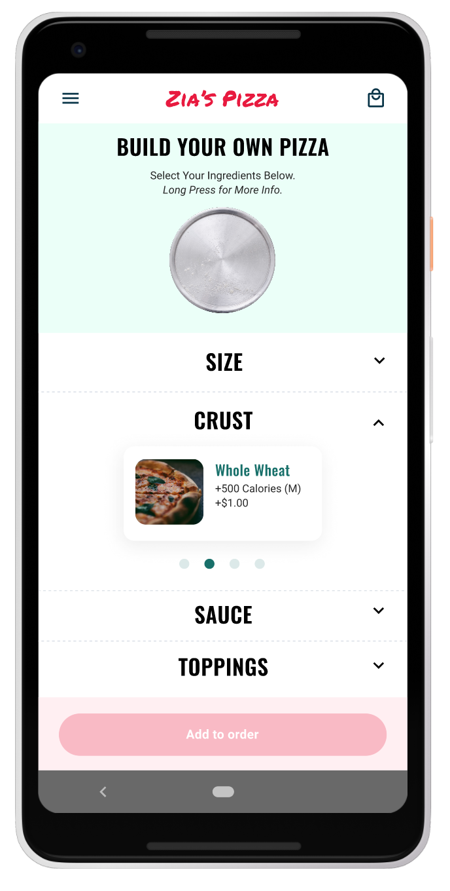
BEFORE USABILITY STUDY
Before usability studies
After usability studies
Early designs allowed for some customization, but after the usability studies, I added additional options to choose pizza crust and sauce. I also revised the design so users see all the customization options when they first land on the screen.

Slide 17
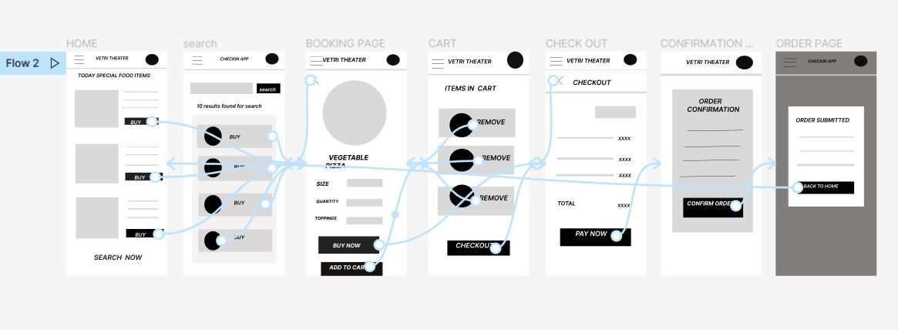
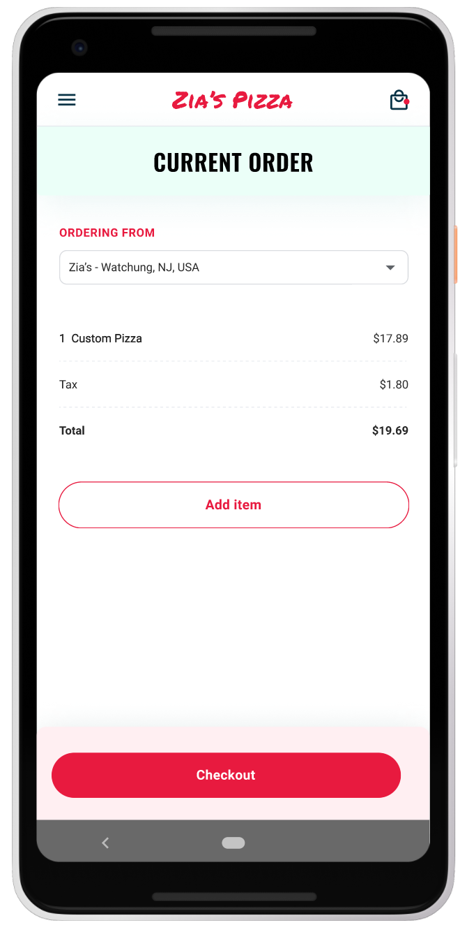
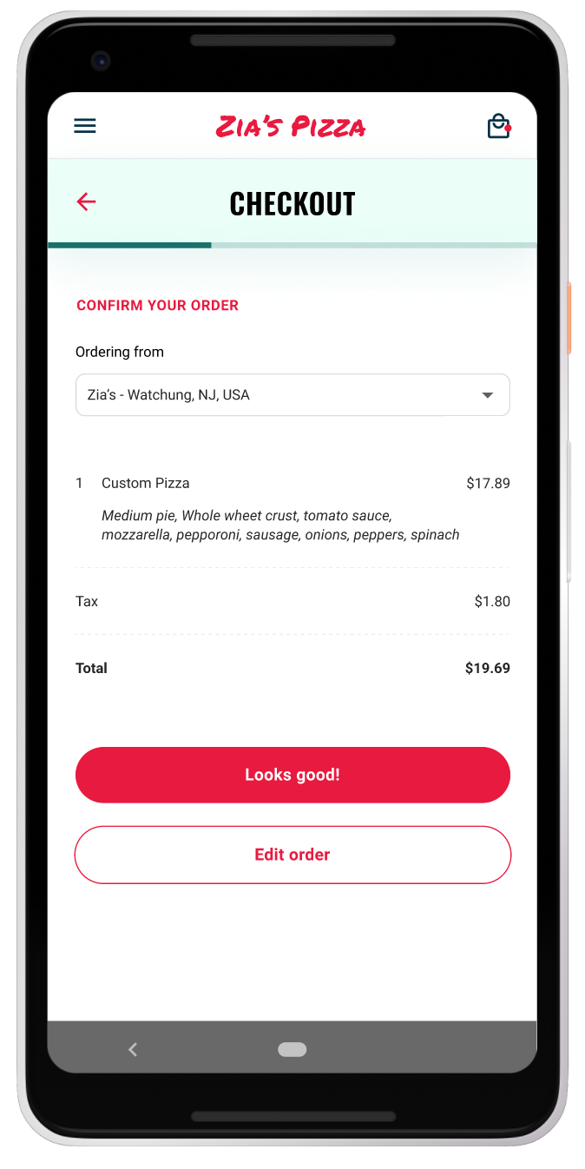
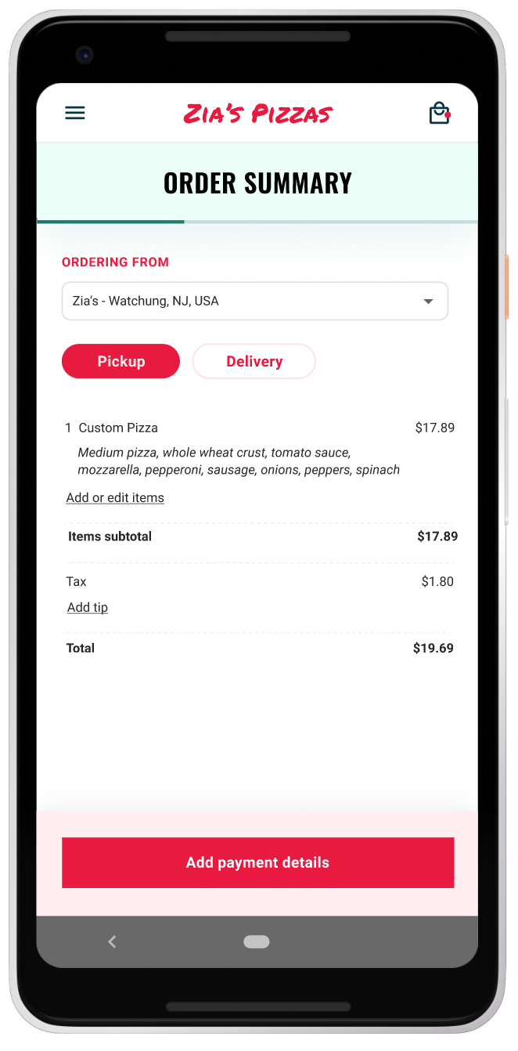
After usability study
Before usability study 2
After usability study 2
The second usability study revealed frustration with the checkout flow. to streamline this flow, I consolidated the “Current order” and “Checkout screens” to one “Order summary” screen.
I also added the pickup or delivery option to this screen.

Slide 18
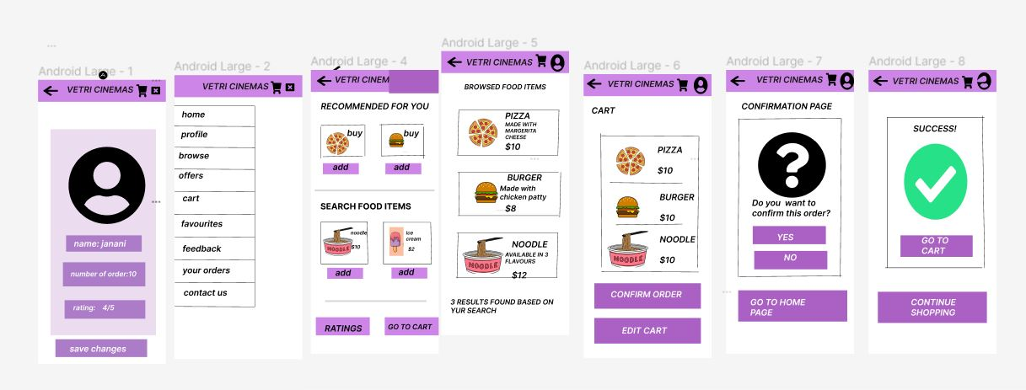
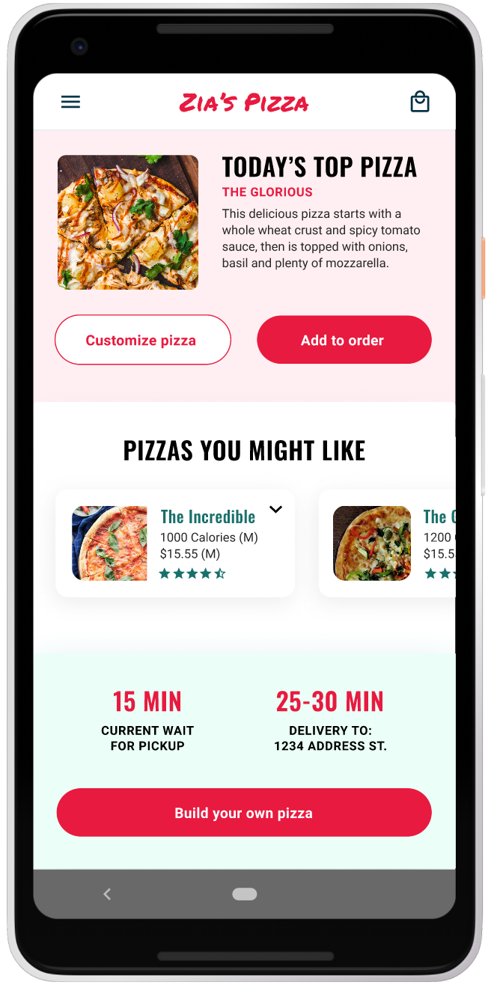
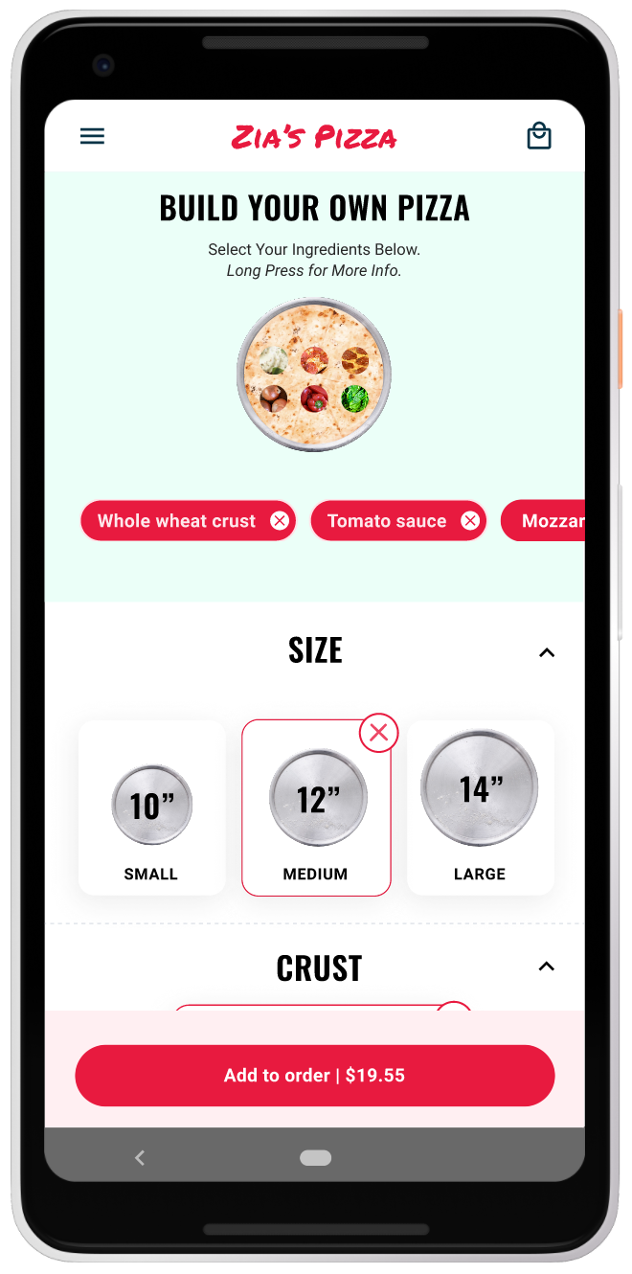
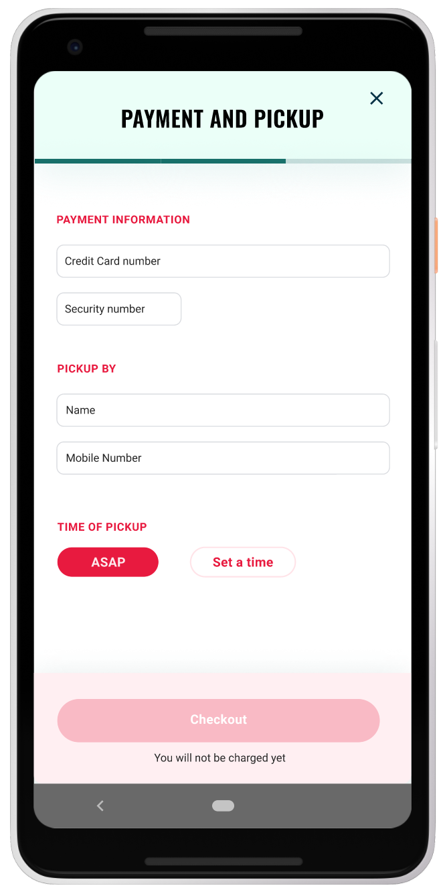
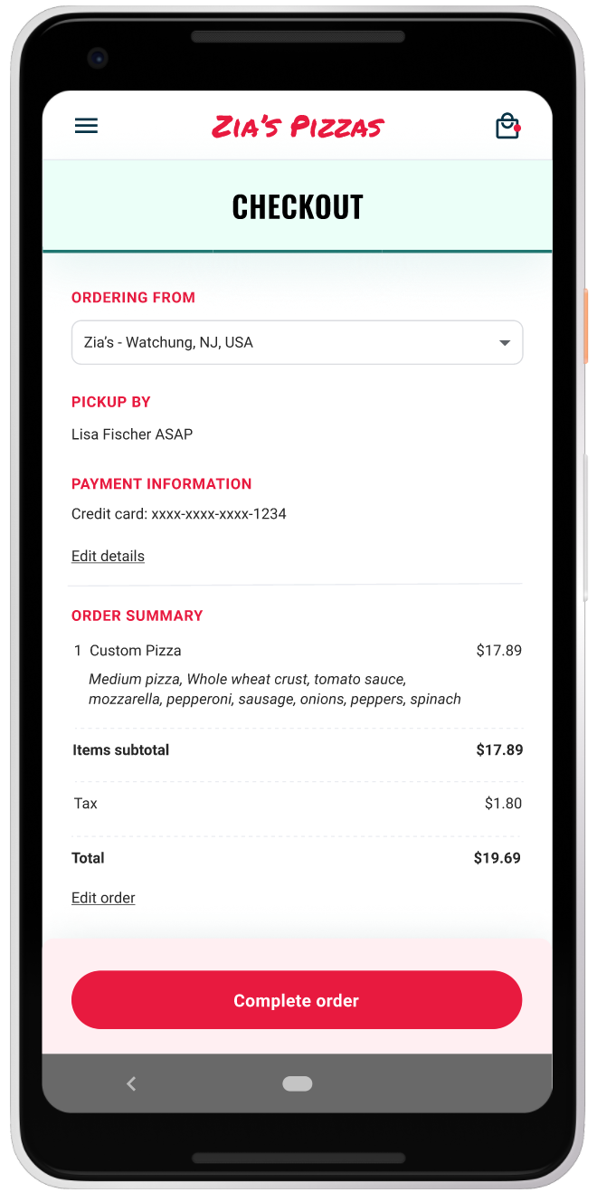
Key mockups

Slide 19
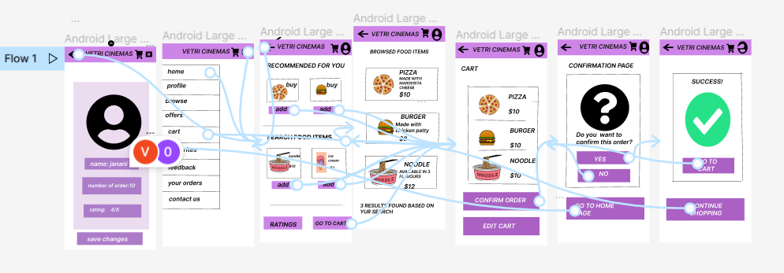
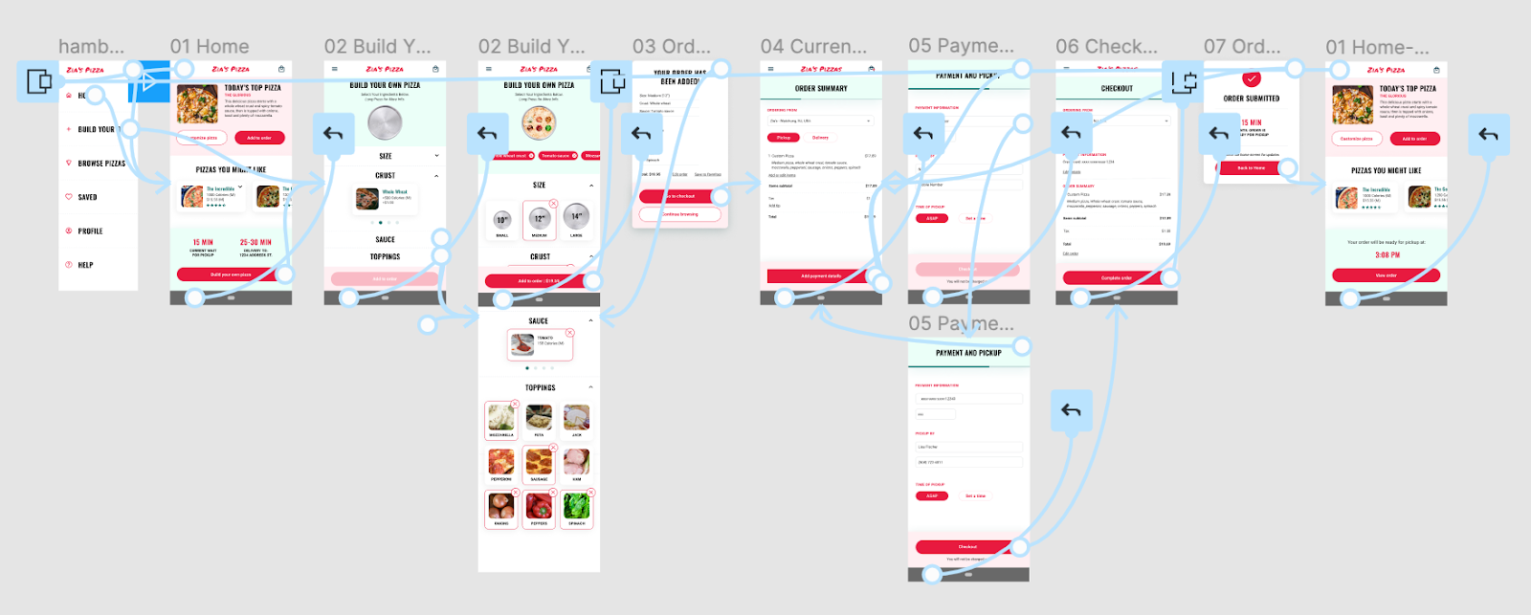
High-fidelity prototype
The final high-fidelity prototype presented cleaner user flows for building a pizza and checkout. It also met user needs for a pickup or delivery option as well as more customization.
View the Zia’s Pizza high-fidelity prototype

Slide 20
Accessibility considerations
1
2
3
Provided access to users who are vision impaired through adding alt text to images for screen readers.
Used icons to help make navigation easier.
Used detailed imagery for snacks items to help all users better understand the designs.

Slide 21
Going forward
Takeaways
Next steps

Slide 22
Takeaways
Impact:
The app makes users feel like Vetri cinemas food app really thinks about how to meet their needs.
One quote from peer feedback:
“The app made it so easy to order my snacks! I would definitely use this app as a go-to for a delicious, fast ordering of snacks in theatres”
What I learned:
While designing the Vetri cinemas food app, I learned that the first ideas for the app are only the beginning of the process. Usability studies and peer feedback influenced each iteration of the app’s designs.

Slide 23
Next steps
1
2
Conduct another round of usability studies to validate whether the pain points users experienced have been effectively addressed.
Conduct more user research to determine any new areas of need.

Slide 24
Let’s connect!
Thank you for your time reviewing my work on the Vetri cineams food app! If you’d like to see more or get in touch, my contact information is provided below.
Email: janani@gmail.com
Website: jaananidesign.uxportfolio.com

Slide 25
Thank you!

